Slide 1
Data Saving
Core Data, UserDefaults, Keychain, Files, Realm, JSON

Slide 2
UserDefaults

Slide 3
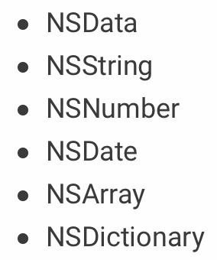
UserDefaults

Slide 4
UserDefaults

Slide 5
Keychain
KeychainAccess
KeychainSwift
SAMKeychain
Encrypted All over the system

Slide 6
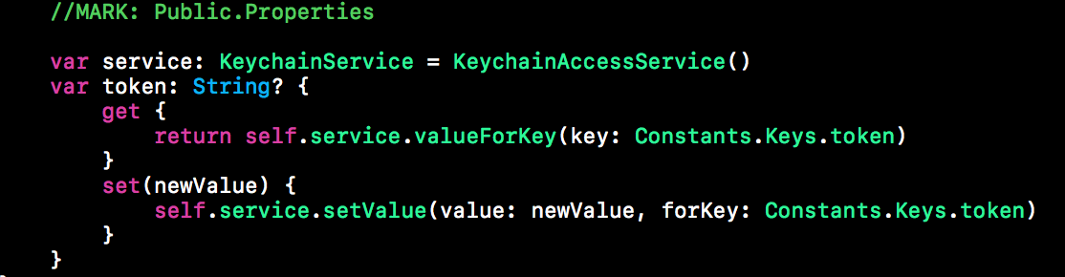
Keychain
Example

Slide 7
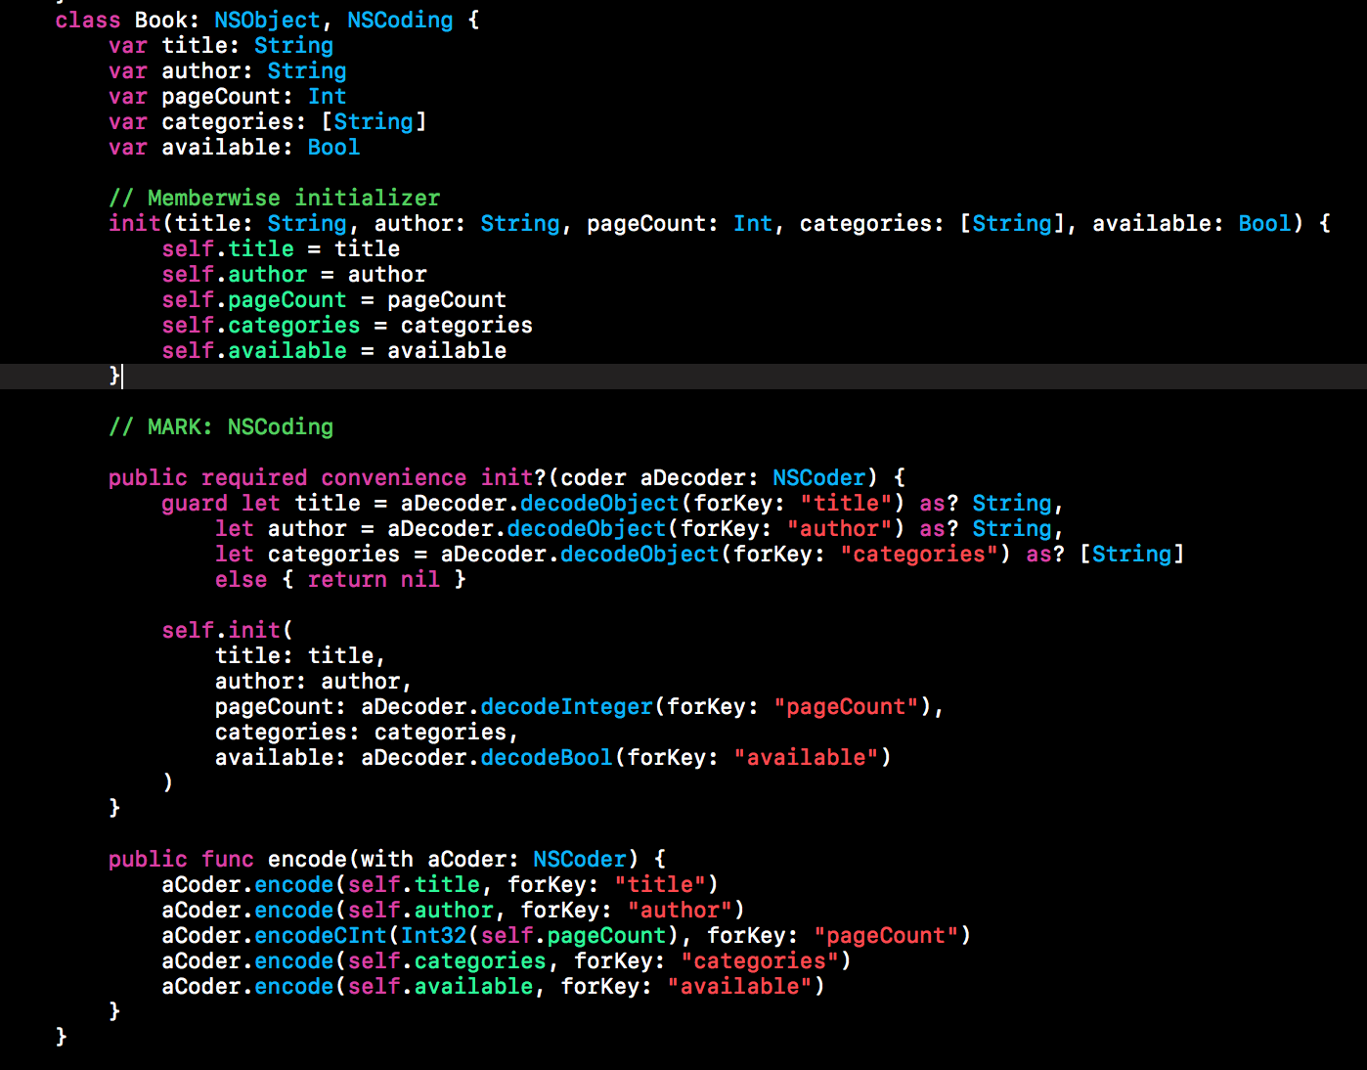
NSCoding

Slide 8
JSON Serialization
JSONSerialization
SwiftyJSON
ObjectMappable

Slide 9
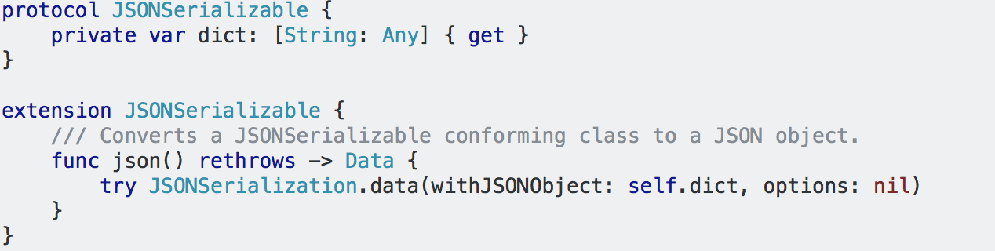
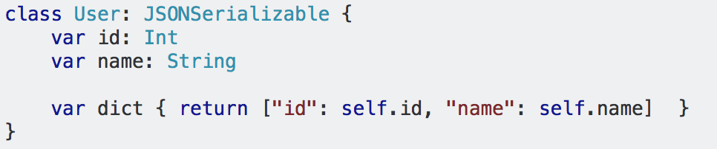
JSONSerialization

Slide 10
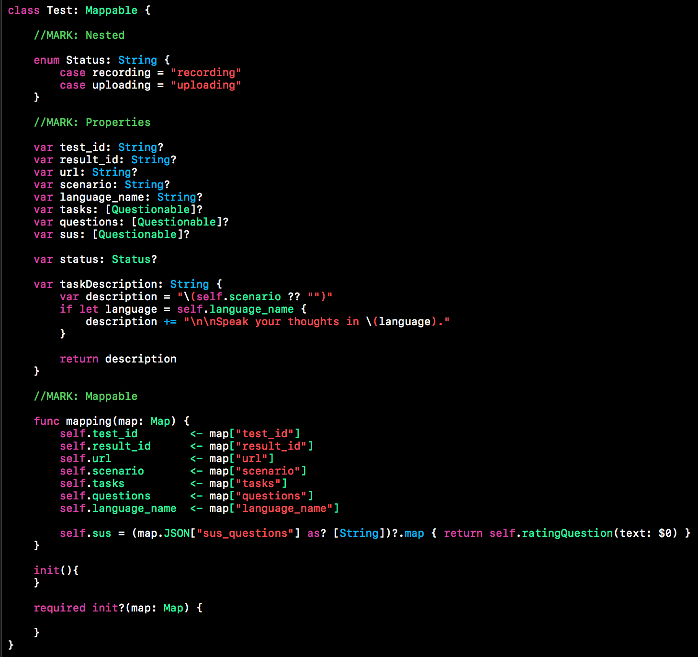
ObjectMapper

Slide 11
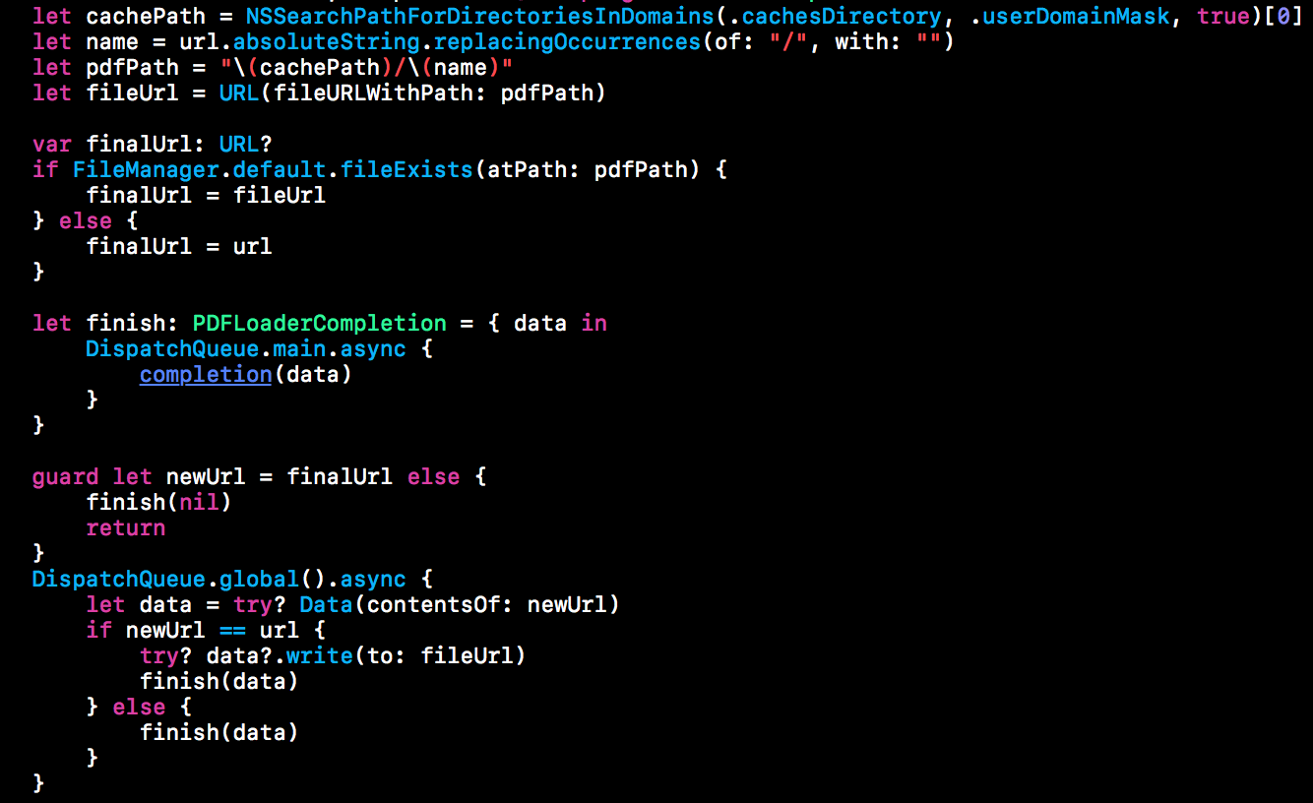
Files
Cache
Documents

Slide 12
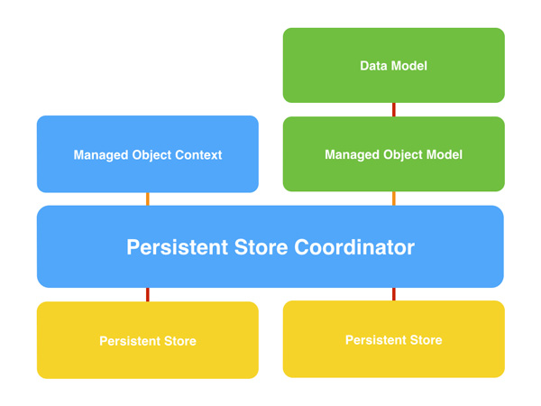
CoreData

Slide 13
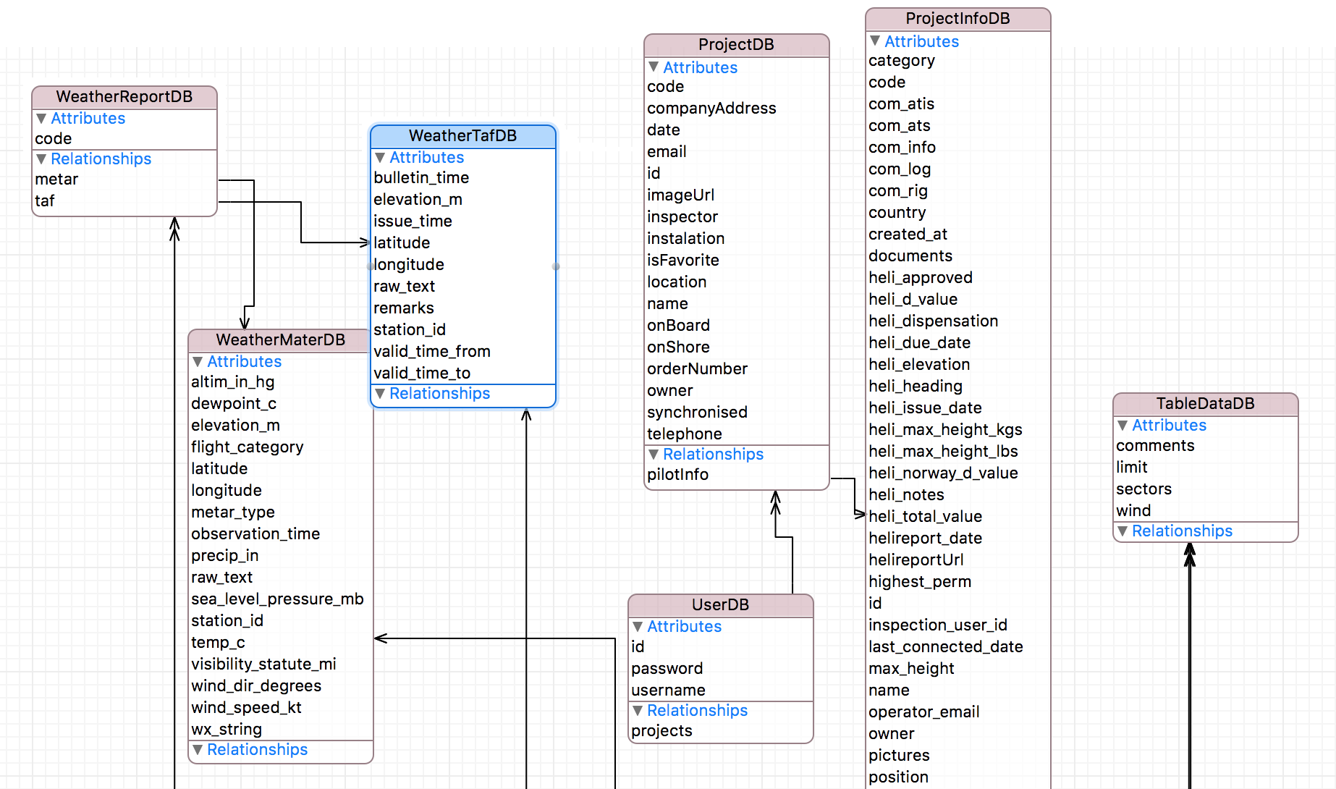
ManagedObjectModel

Slide 14

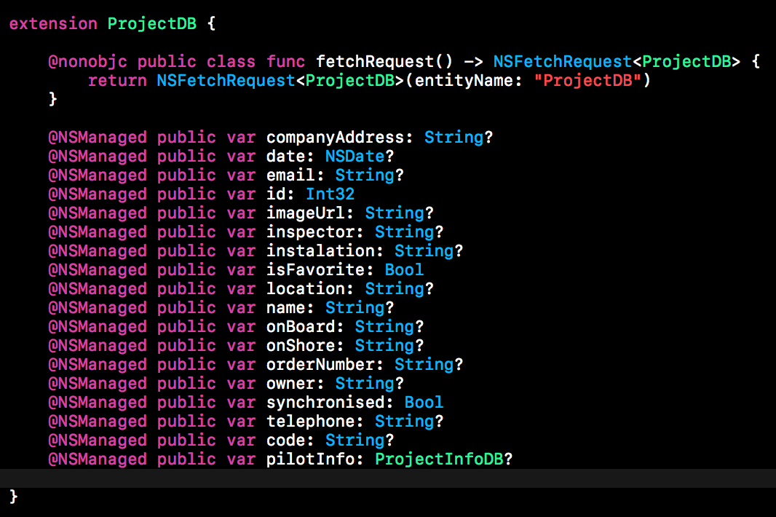
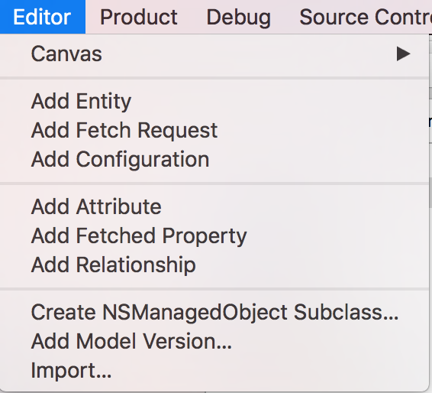
NSManagedObject

Slide 15
Realm
https://realm.io/docs/tutorials/realmtasks/
Faster, Easier, Flexible, Great Guide

